Slide 1


TypeScript
Your gateway drug to the JavaScript world
Notes:
TypeScript is JavaScript’s runtime with a compile-time type checker

Slide 2
Why this talk?

Slide 3
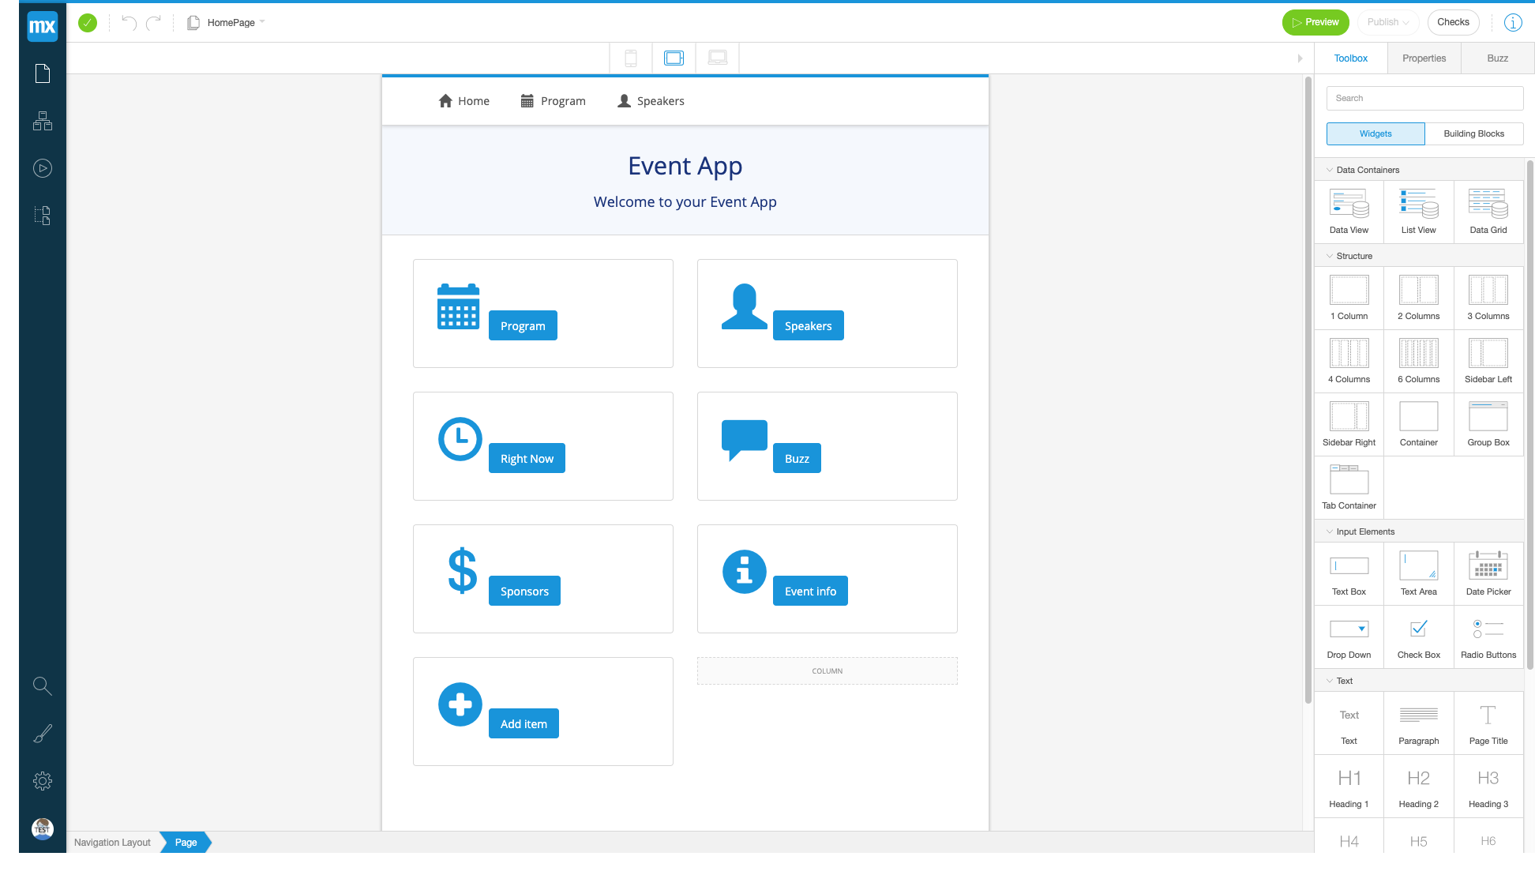

Slide 4


Slide 5


Slide 6


Slide 7
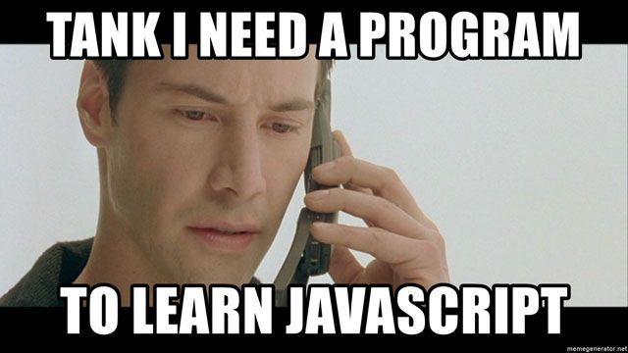

Slide 8
Why JavaScript?

Slide 9
TypeScript
JavaScript
Notes:
You can’t learn TypeScript without learning JavaScript! TypeScript shares syntax and runtime behavior with JavaScript, so anything you learn about JavaScript is helping you learn TypeScript at the same time.

Slide 10


Benefits
Sharing knowledge
Sharing resources
Testers become more involved in application codebase
Developers become more invested in e2e automation
Better testing
Notes:
Shared resources:
-locators
-texts
-methods

Slide 11


Slide 12
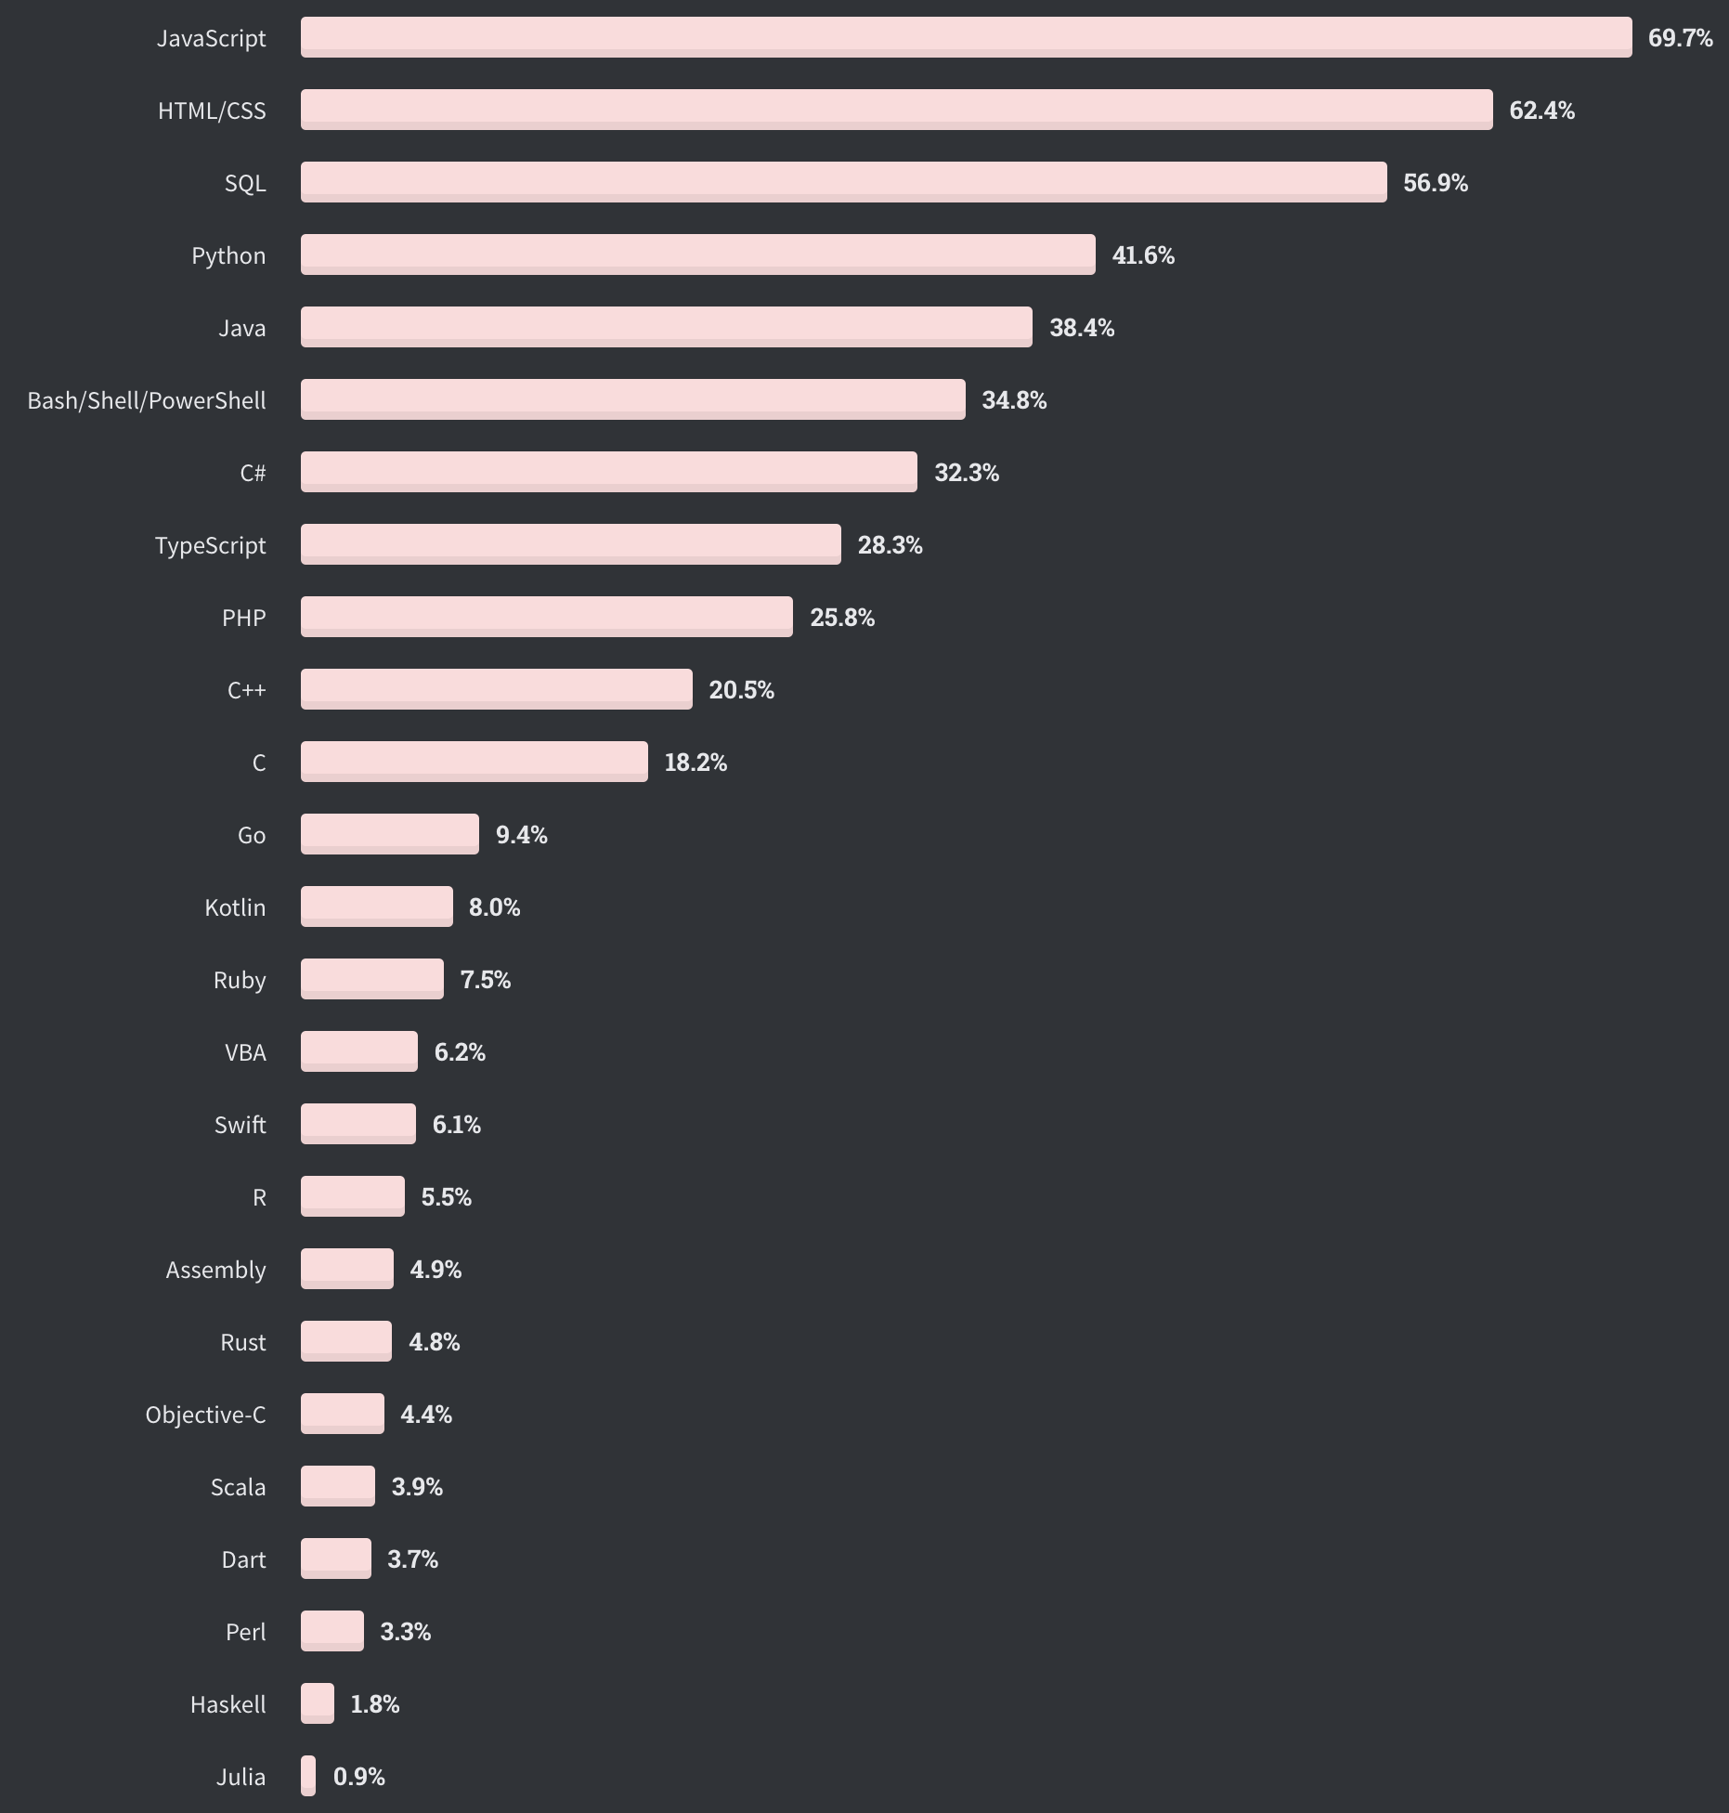
Commonly used languages https://insights.stackoverflow.com/survey/2020

Slide 13

Notes:
Frontend: webbrowsers
Backend: NodeJS
Mobile: ReactNative
Desktop: Electron

Slide 14
https://applitools.com/blog/language-software-test-automation/

Slide 15

Notes:
Sad and angry

Slide 16
Challenges

Slide 17

Notes:
-Backend, frontend, mobile
-Package managers (npm, yarn)
-Linters (eslint)
-Formatters (prettier)
-Packagers (webpack, browserify)
-Compilers/Transpilers (babel, typescript)
-State management (react, redux, flow)
-…

Slide 18
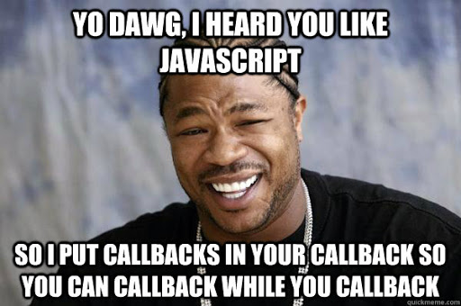

Slide 19
Demo
Async behavior
https://github.com/ablok/TAD2020
Notes:
Callback
Promise
Async/await

Slide 20

Notes:
You can use functions without classes

Slide 21
Demo
$^#&@%
https://github.com/ablok/TAD2020

Slide 22
TypeScript
The power of a dynamic language with the safety of a typed language
Notes:
Plain JavaScript generates errors only at runtime, and then only if your program happens to reach a path with errors.

Slide 23
TypeScript
TypeScript
Static typing
Optional
New language features
Enhanced IDE experience
JavaScript

Slide 24
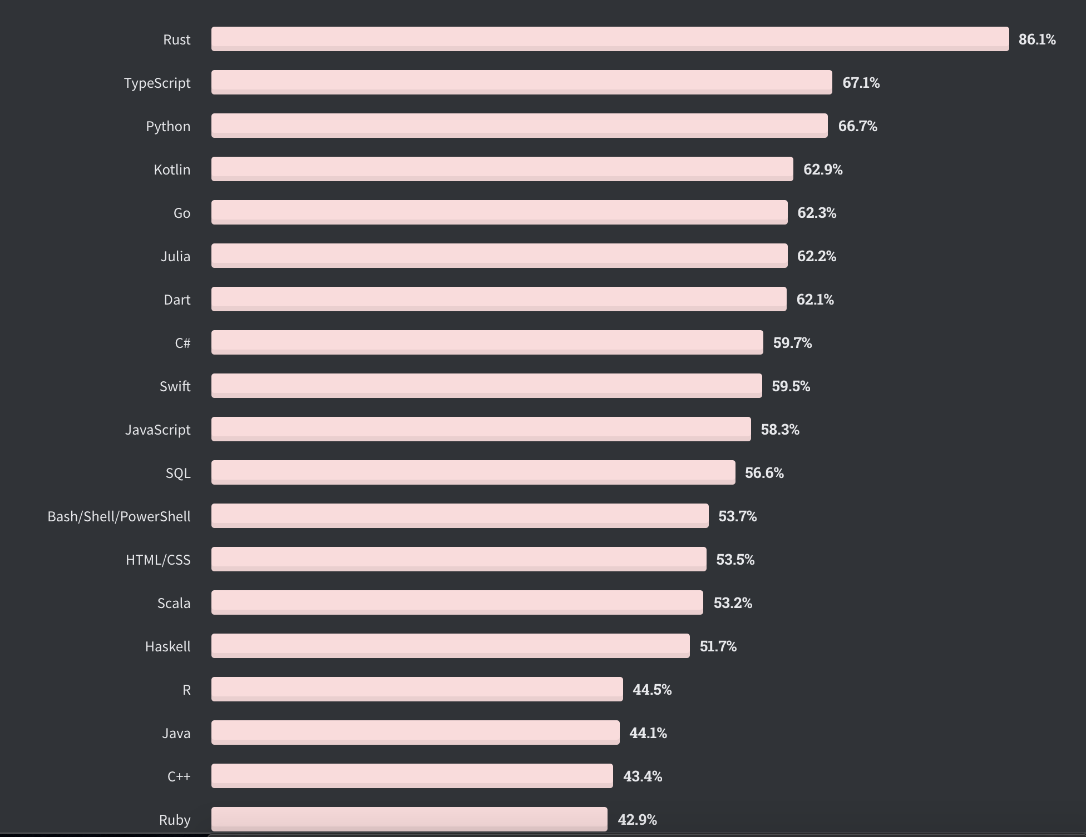
Most loved languages https://insights.stackoverflow.com/survey/2020

Slide 25
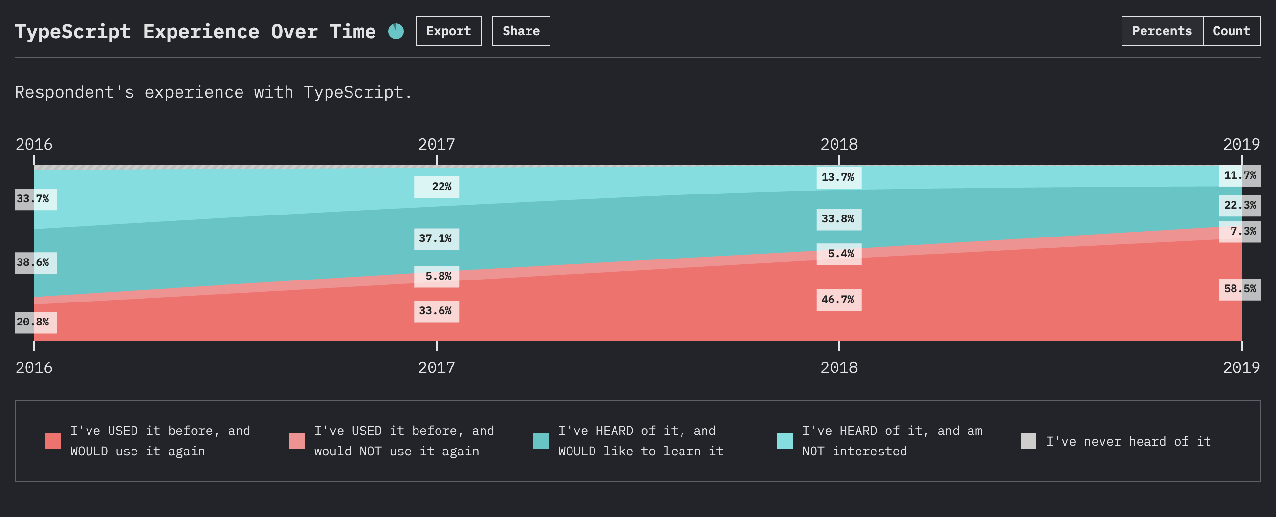
https://2019.stateofjs.com/javascript-flavors/typescript/

Slide 26
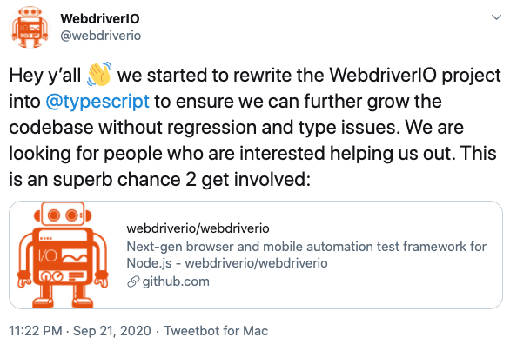

Slide 27
Demo
TypeScript
https://github.com/ablok/TAD2020

Slide 28
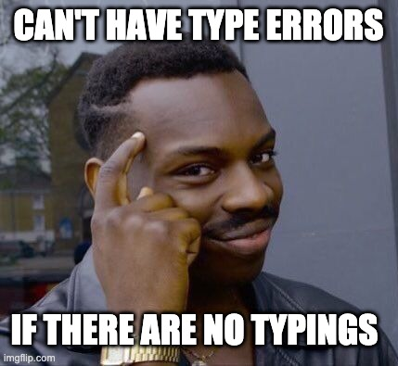
Flaws
Only as good as the typings
Typings are not always available
Needs to be transpiled
Only at design time

Slide 29

Lessons learned
Write your automated tests in the same language as your application code
Learn JavaScript. It is very popular and used everywhere
TypeScript can help you write better and more maintainable JavaScript code

